Slide 1
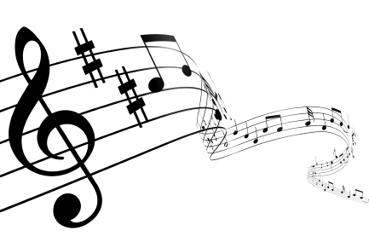
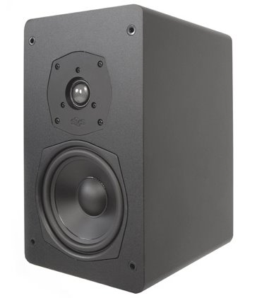
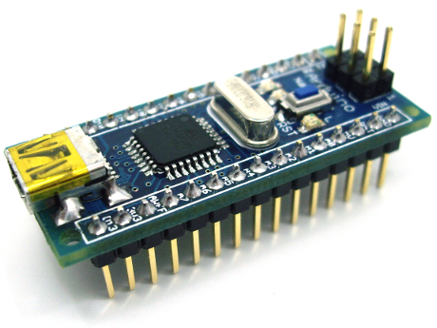
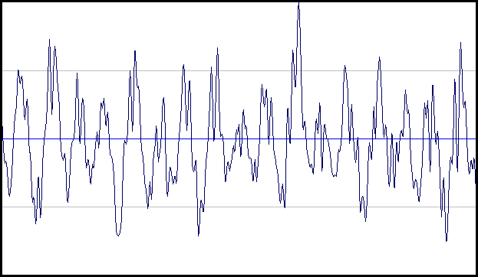
Audio Lab
Marc Lichtman

Slide 2
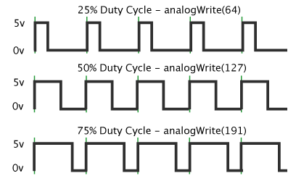
Tone Function
tone(9, 400);
First parameter = pin to use
Second parameter = frequency in Hertz

Slide 3
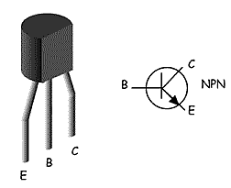
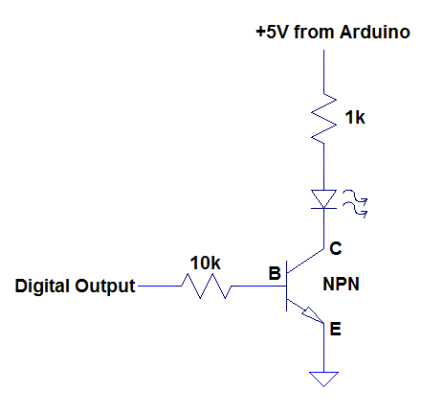
Hardware
Software
Use this code to test your speaker
5V (On Arduino)
void setup() {
pinMode(9, OUTPUT);
// change 9 with whatever pin you use
}
void loop() {
tone(9,1000); //use 1000 Hz tone
delay(500); //delay 500ms (0.5 seconds)
tone(9,500); //use 500 Hz tone
delay(500); //delay 500ms (0.5 seconds)
}
200
red-black-brown
Speaker
TONE
2k
red-black-red
When you have it working, take 5 minutes to make some fun sounds
(try using for loops)

Slide 4
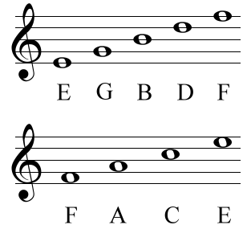
Musical Frequencies
#define C 261 //in Hz
#define D 294
#define E 329
#define F 349
#define G 392
#define A 440
#define B 493
Be sure to use capital letters!

Slide 5
Musical Frequencies
#define C 261 //in Hz
#define D 294
#define E 329
#define F 349
#define G 392
#define A 440
#define B 493
#define R 40000
#define END 0

Slide 6
Array of Notes and Duration
int music[] = {C,D,E,F,G,A,B,C*2,END}; //notes you want to play
int duration[] = {1,1,1,1,1,1,1,1}; //duration of each note in seconds
Hints:
C*2 is used to make the “higher pitch” C
Use END to tell your program when to stop reading the array
For every note, there should be a duration

Slide 7
Play the Music
void setup() {
pinMode(9, OUTPUT);
}
void loop() {
int i = 0;
while (music[i] != END) //runs until it reaches “END”
{
tone(9,music[i]);
delay(duration[i]*1000); //convert to milliseconds
i++;
}
}

